Slide 1
Topic 1
Disk Management
Notes:
12/9/2022
1
1

Slide 2
What is Disk ?
Disk is used to store the user infomation.
Notes:
12/9/2022
2
2

Slide 3
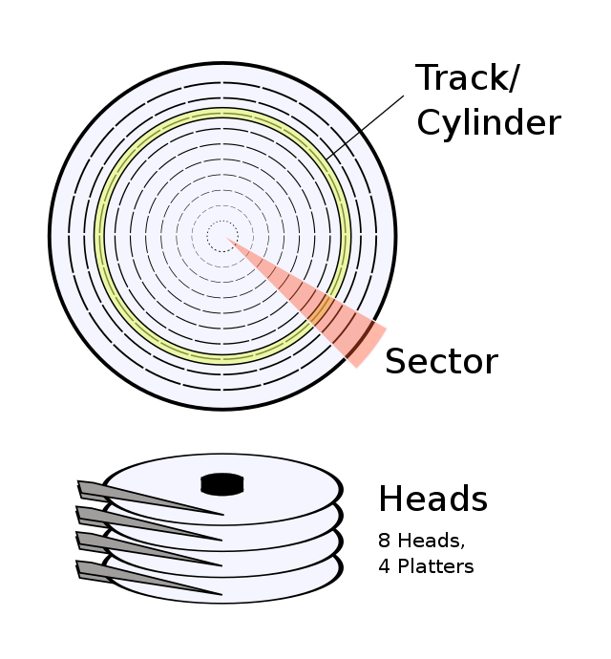
How does HDD store DATA
Sector Wise
1.In a computer disk storage ,a sector is a subdivision of track on a ,magnetic disk or optical disc .
2.Sector stores a fixed amount of user accessible data.
Cluster Wise
1. A cluster ,in the context of a hard disk , is a group of sectors with in disk and is the grouping by which disk files are organised .
2. A cluster is a larger than a sector ,a nd most files fill many clusters of disk space
Notes:
12/9/2022
3
3

Slide 4
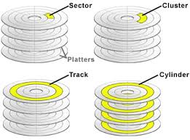
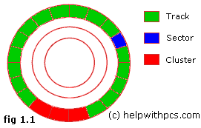
Track wise
1.A disk drive track is a circular path on the surface of a disk on which information is magnetically recorded and from which recorded information is read.
2. the concept is concentric ,through the physical platters,being a data circle per each cylinder of the whole disk drive
Cylinder wise
1. a cylinder is any set of all of tracks of equal diameter in a hard disk drive (hdd).it can be visualised as a single , imaginary , circle that cuts through all of the platters (and both sides of each platter ) in the drive .
Notes:
12/9/2022
4
4

Slide 5
what is file system?
In computing, file system or filesystem is a method and data structure that the operating system uses to control how data is stored and retrieved.
There is two type of Files System
1. FAT - File Allocation Table
2. NTFS - New Technology file system
Notes:
12/9/2022
5
5

Slide 6
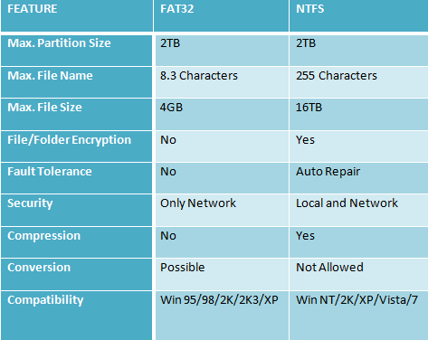
Difference Between FAT32 and NTFS
Notes:
12/9/2022
6
6

Slide 7
Disk Partition
1.Open Disk Management.
2.When Disk Management opens, you should see an Initialize Disk window with the message "You must initialize a disk before Logical Disk Manager can access it."
3.On this screen, you're asked to choose a partition style for the new hard drive. Choose GPT if the new hard drive you installed is 2 TB or larger. Choose MBR if it's smaller than 2 TB.
ocate the hard drive you want to partition from the drive map at the bottom of the Disk Management window.
4.You might need to maximize the Disk Management or Computer Management window to see all the drives on the bottom. An unpartitioned drive will not show up in the drive list at the top of the window
Notes:
12/9/2022
7
7

Slide 8
5.Once you've found the space you want to partition, tap-and-hold or right-click anywhere on it, and choose New Simple Volume.
6.Choose Next > on the New Simple Volume Wizard window that appeared.
7.Choose Next > on the Specify Volume Size step to confirm the size of the drive you're creating
8.Select Next > on the Assign Drive Letter or Path step, assuming the default drive letter you see is OK with you.
9.Choose Do not format this volume on the Format Partition step, and then select Next >.
10.Verify your choices on the Completing the New Simple Volume Wizard screen, which should look something like this:
11.Choose Finish and Windows will partition the drive, a process that will only take a few seconds on most computers.
12.Next, Windows will try to open the new drive automatically. However, since it's not yet formatted and can't be used, you'll see this message instead: "You need to format the disk in drive F: before you can use it. Do you want to format it?"
13.Select Cancel
Notes:
12/9/2022
8
8

Slide 9
Topic 2
TASK SCHEDULER
Notes:
12/9/2022
9
9

Slide 10
What is Task Scheduler
The Task Scheduler is a tool included with Windows that allows predefined actions to be automatically executed whenever a certain set of conditions is met. For example, you can schedule a task to run a backup script every night, or send you an e-mail whenever a certain system event occurs.
Notes:
12/9/2022
10
10

Slide 11
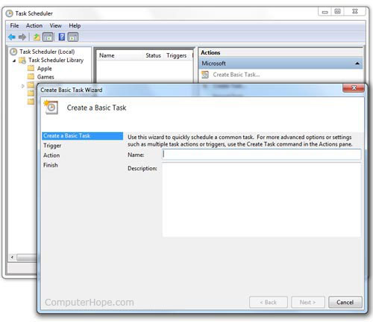
How to create task scheduler
Step 1. Start the "Create Basic Task" wizard
Step 2. Name the task and give it a description
Step 3. Choose when to execute the new task
Step 4. Set the action that you want to be executed
Step 5. Check the details of the new task and save it
Notes:
12/9/2022
11
11

Slide 12
How to delete scheduled task
Go to the Scheduled Tasks app let in Control Panel, right-click the task you want to delete, and select Delete from the displayed context menu. Click Yes to confirm the deletion.
Notes:
12/9/2022
12
12

Slide 13
Topic 3 event veiwer
Notes:
12/9/2022
13
13

Slide 14
What is Event Viewer ?
Event Viewer is a component of Microsoft's Windows operating system that lets administrators and users view the event logs on a local or remote machine.
Notes:
12/9/2022
14
14

Slide 15
How to open Event viewer
Open Windows Control Panel
Click System and Security
Click Administrative Tools
Double-click Event Viewer.
Notes:
12/9/2022
15
15

Slide 16
Advantages
1.Monitor all Events in one place.
2. Save time
Notes:
12/9/2022
16
16

Slide 17

Notes:
12/9/2022
17
17

